Slide 1




The Optimal Model: Machine Learning - based Sell-Side Equity Research
Group 5

Slide 2


Executive Summary
Four Categories of Indicators:
Technical Indicators
Fundamental Indicators
Macro Indicators
News Sentiment Indicators
Three Predicted Machine Learning Models:
Random Forest
Logistic Regression
Neural Network
GOAL: Determine the BEST Classification Model to determine our Buy or Sell Recommendation

Slide 3

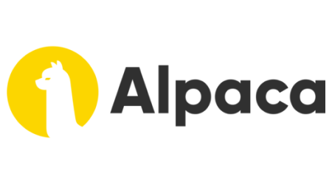

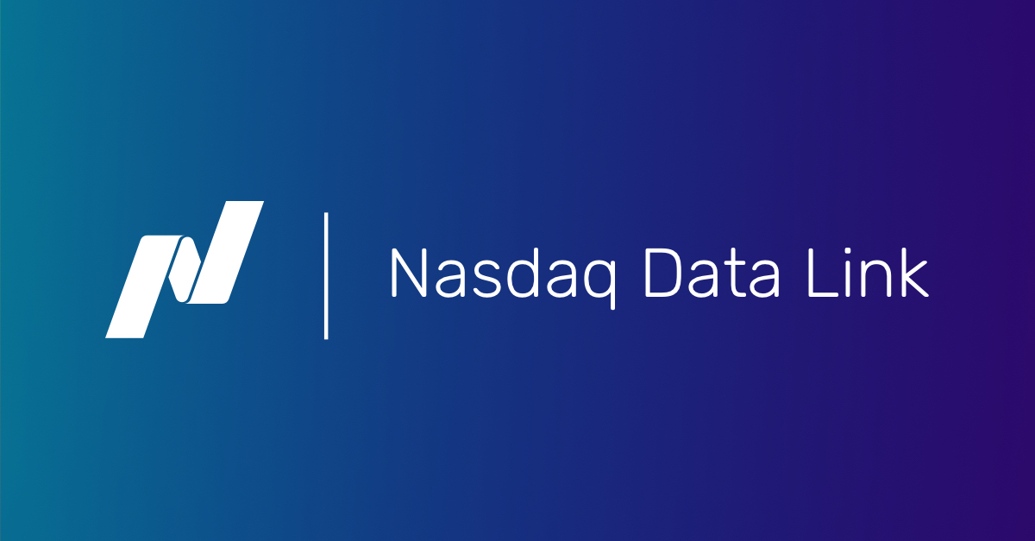
Data Preparation & Model Training Process
Notes:
[Sources]
Alpaca Logo; https://www.finder.com/alpaca-trading-review
YFinance Logo; https://rjunaidraza.medium.com/yahoo-finance-api-to-get-stocks-tickers-data-in-python-c49820249a18
NASDAQ Logo; https://data.nasdaq.com/tools/python
Yahoo Finance Logo; https://finance.yahoo.com/video/yahoo-finance-live-jul-31-133931771.html

Slide 4
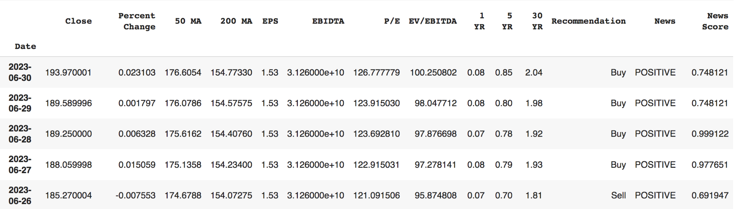
Data Preparation & Model Training Process
Technical Indicators
2. Fundamental Indicators
3. Macro Indicators
4. News Sentiment
Notes:
[Sources]
Alpaca Logo; https://www.finder.com/alpaca-trading-review
YFinance Logo; https://rjunaidraza.medium.com/yahoo-finance-api-to-get-stocks-tickers-data-in-python-c49820249a18
NASDAQ Logo; https://data.nasdaq.com/tools/python
Yahoo Finance Logo; https://finance.yahoo.com/video/yahoo-finance-live-jul-31-133931771.html

Slide 5
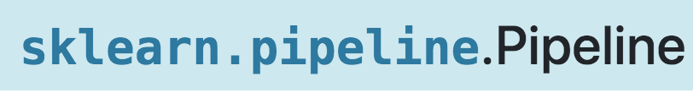
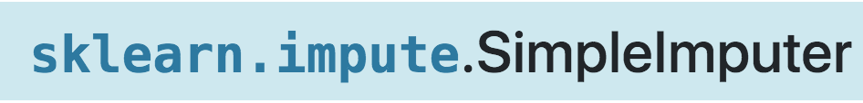
Data Preparation & Model Training Process
Notes:
[Sources]
Alpaca Logo; https://www.finder.com/alpaca-trading-review
YFinance Logo; https://rjunaidraza.medium.com/yahoo-finance-api-to-get-stocks-tickers-data-in-python-c49820249a18
NASDAQ Logo; https://data.nasdaq.com/tools/python
Yahoo Finance Logo; https://finance.yahoo.com/video/yahoo-finance-live-jul-31-133931771.html

Slide 6

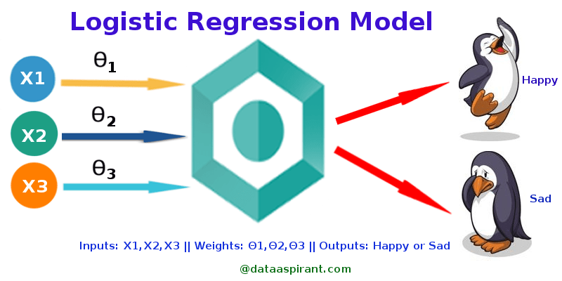
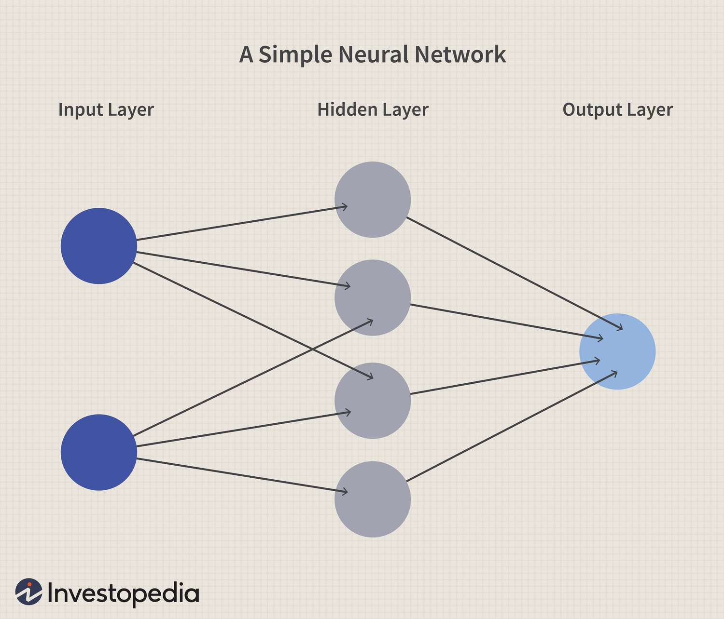
The Three Models
Notes:
Random Forest:
Random forests or random decision forests is an ensemble learning method for classification, regression and other tasks that operates by constructing a multitude of decision trees at training time. For classification tasks, the output of the random forest is the class selected by most trees.
Logistic Regression:
Logistic regression is a supervised machine learning algorithm mainly used for classification tasks where the goal is to predict the probability that an instance of belonging to a given class or not. It is a kind of statistical algorithm, which analyze the relationship between a set of independent variables and the dependent binary variables.
Neural Network:
a method in artificial intelligence that teaches the model to process data by using interconnected nodes

Slide 7
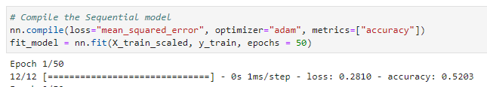
0.4701
Neural Network
MODEL 1 ACCURACY SCORE
Loss Function | Categorical Cross- Entropy
Number of Hidden Nodes | 10
Number of Neurons | 2
Optimizer Function | “sigmoid”
After backtesting and manual optimization, we found the neural network to be less than ideal for predicting the correct BUY or SELL classification.
0.5203
MODEL 2 USING FEATURE ENGINEERING
Loss Function | Mean Squared Error
Number of Hidden Nodes | 20
Number of Neurons | 3
Optimizer Function | “adam”

Slide 8

Our first attempt the predictors using Apples P/E ratio, and 50 and 200 day MA, and included other variables of 1 and 5 year treasury yields and a news score based on sentiment. Running this model resulted in a 57% Precision Score.
MODEL 1: MODEL 2: Feature Engineering
A mix of technical, fundamental, macro, and proprietary data (NLP Analysis)
Random Forest
Varying the feature selection to yield the highest accuracy
The second Random Forest attempt using 23 years of price data with predictors of daily Apple; volume, open, high, low and close prices resulted in a 55% Precision score.
MODEL 2: POST FEATURE-ENGINEERING
Utilizing standard fundamental analysis, ratios, and metrics

Slide 9
Logistic Regression
Our first few attempts, yielded us low precision and recall scores of about 70%. Using more parameters to improve this score like sentiment and EPS we kept changing the dataset until we found the best.
TEST #1:
Used a mix of volume, open, high, low, close and MA
This model deemed to be ideal for Apple stock, using the various parameters we continued to improve the model to yield the highest results
Using 'EBIDTA', 'EV/EBITDA', 'EPS', 'P/E', '1 YR', '5 YR', '30 YR', '50 MA', '200 MA', 'News', 'News Score', 'Percent Change', 'Target - B/H/S (based on close - daily % change)' all the parameters we have currently in our dataset we yielded the best results. We had to change the news and target columns to numerical values so that the model would be able to accept the data.
TEST #2
We had more than twice the original parameters and incorporated sentiment, technical, fundamental, and macro analysis.

Slide 10
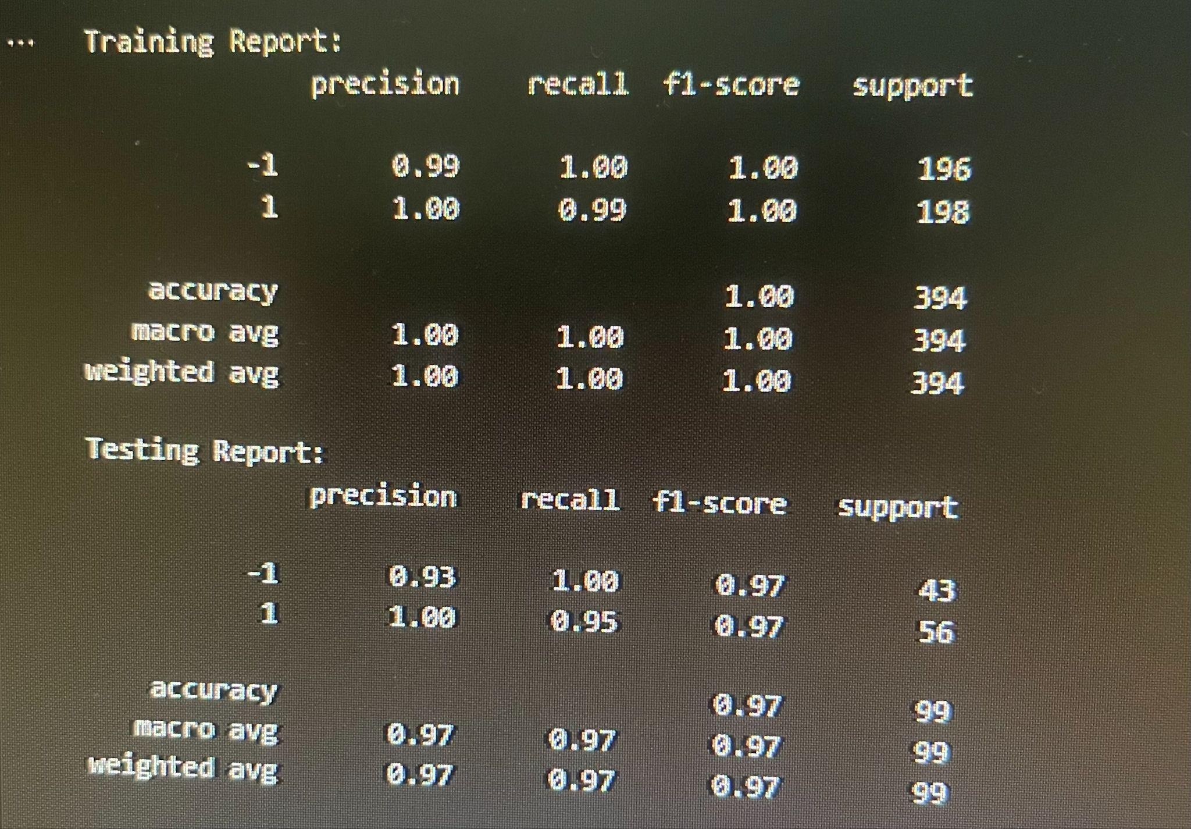
The two first models we did not produce ideal results
Not having enough data
Working with different parameters
Splitting training and testing sets at different times
The Logistic Regression model
Pipeline
Hyperparameter tuning
C(or regularization strength)
Penalty
Grid search for finding best model
Finding the best combination of hyperparameters values
Results & Conclusion

Slide 11






Next Steps
Feature engineering and selection for all three ML models
fundamental, technical, and macro to improve predictive accuracy
More hyperparameter tuning with the Neural Network
experimenting with different optimizer, loss, activation functions and number of epochs
Taking into account the street consensus - picking a different stock
AAPL has gone up consistently for 8 years - so maybe better to just hold instead of trade this stock - or pick a more volatile stock
at that given moment in time (averaging the B/S/H of major players) recommendations into our data instead of using price action data
Better data cleaning and collection
what is correlated to stock performance
correcting the dataset to have holds, instead of only buy and sell
coming up with our own proprietary metrics using alternative data
gathering more data than 2 years to catch economic cycles
Improving the NLP aspect of the project
scanning more articles, etc.

Slide 12
Questions?

